Slide 1

Carnatic Notes Generator Using Audio Segmentation and Processing in Python with Streamlit
DIVA_CODERS : IN12
Anjana MP
Pradeepa K

Slide 2
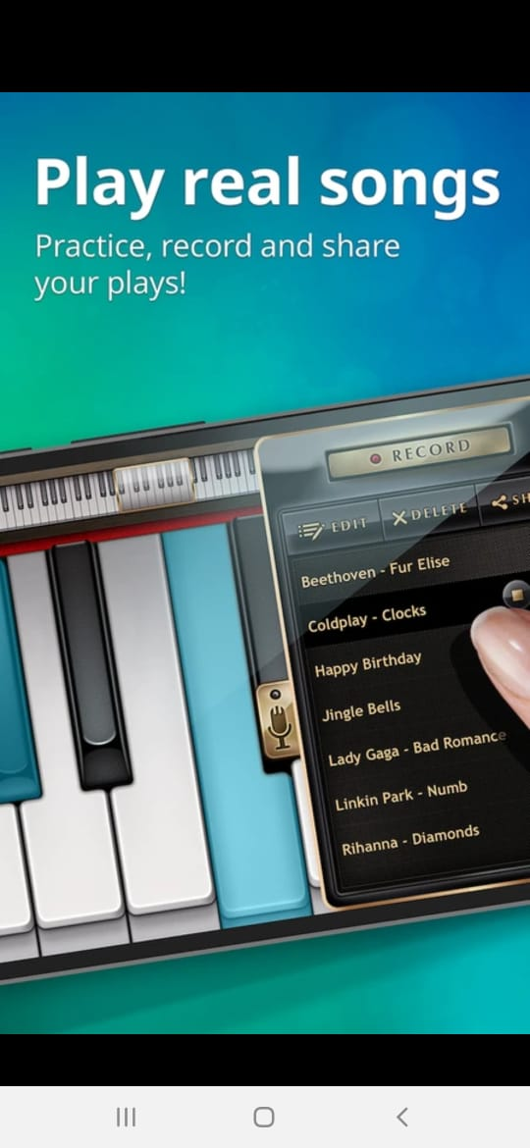
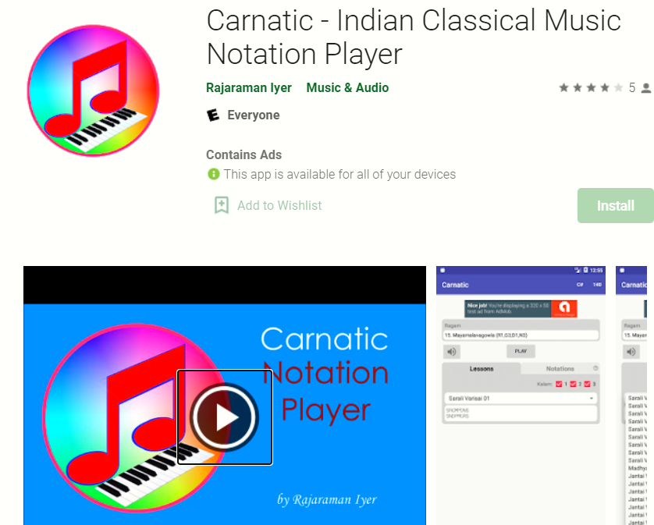
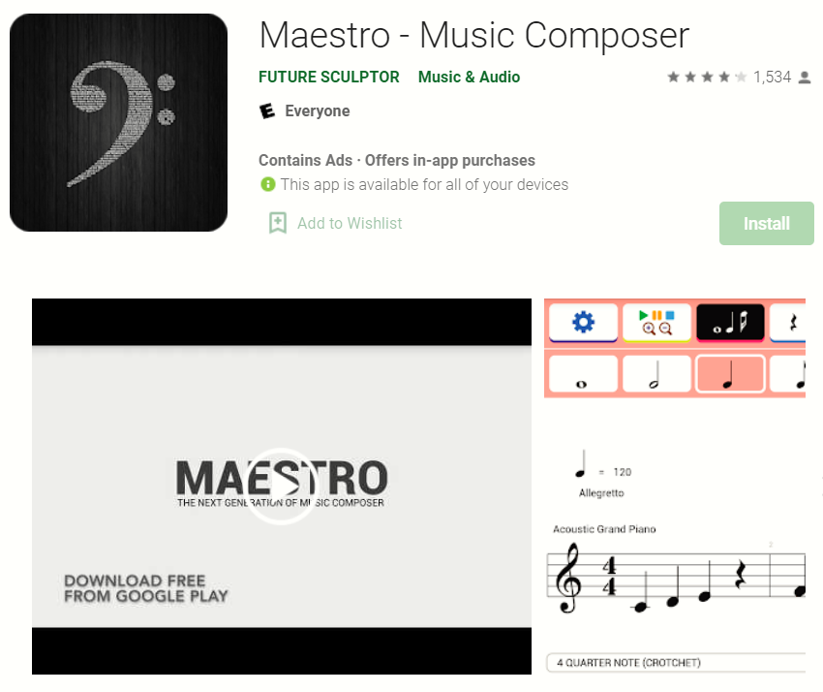
Current Musical Apps - Scope
2. MUSIC SHEET GENERATOR
3.KEYS GET HIGHLIGHTED FOR LIMITED SONGS
1. TYPE THE NOTES HEAR THE TUNE

Slide 3
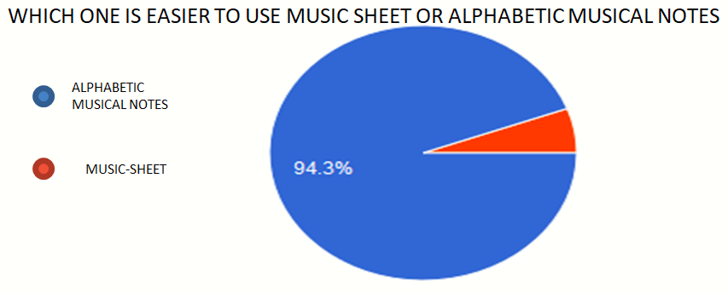
HOW ARE APP IS DIFFERENT
CURRENT APPS
CARNATIC NOTE GENERATOR APP
GENEARTE MUSIC SHEET(MUSICAL NOTATION – DIFFICULT TO INTERPRET FOR BEGINNERS)
DISPLAY HIGHLIGHTED KEYS OF KEYBOARD FOR LIMITED SONGS
ALLOWS YOU TO UPLOAD ANY MP3 TUNE
RECORD ANY PIANO/KEYBOARD TUNE
DISPLAYS THE ALPHABETIC CARNATIC NOTATIONS FOR THE TUNE INPUT
ALPHABETIC CARNATIC NOTATIONS IS EASIER TO INTERPRET

Slide 4
MODULES BUILT
Uploading
Internal storage
Beats per minute
Audio Processing
Output
In App results display
In App recorder
Classification
Separate text file creation
Feature extraction
Audio Segmentation

Slide 5
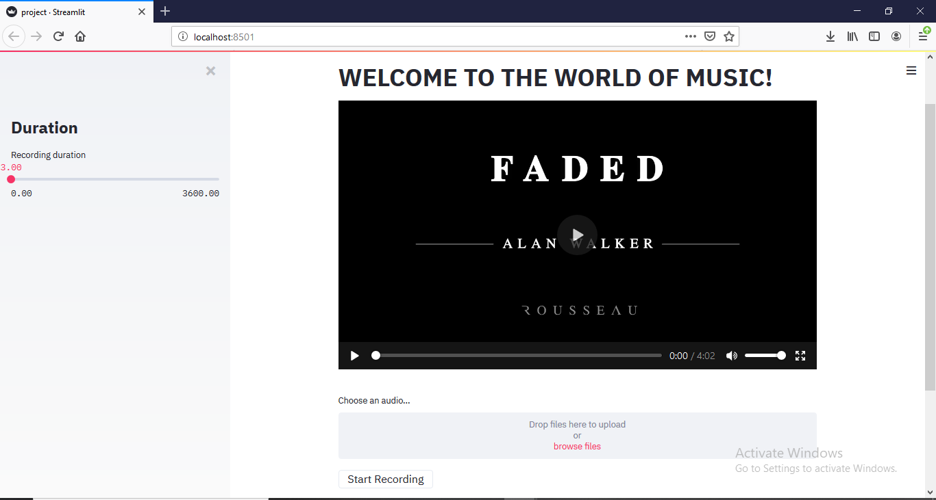
USER INTERFACE

Slide 6
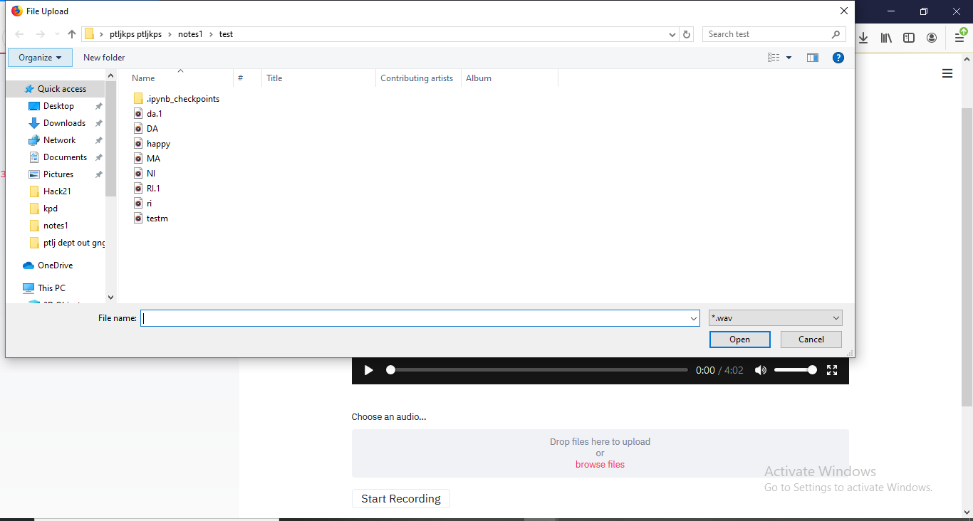
UPLOAD MODULE

Slide 7
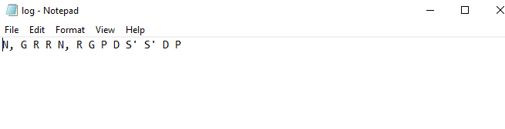
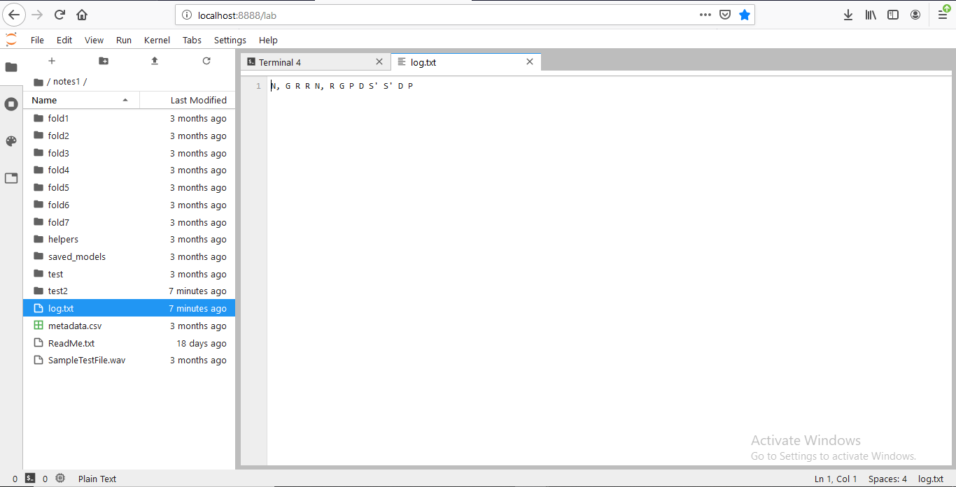
TEXT FILE WITH NOTES GENERATED

Slide 8
NEURAL NETWORK CONSTRUCTION
MLP
CNN
Activation function:
RELU
SOFTMAX
Layers:
Conv2D
Dense
Epochs : 75
Data Records : 640 (32*20)

Slide 9
VIDEO DEMONSTRATION
https://drive.google.com/file/d/1pcK-zRqDWF59YnEzBSza6tFj2vEEqTVw/view?usp=drivesdk

Slide 10
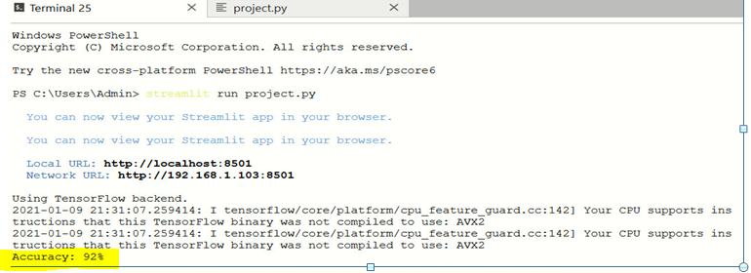
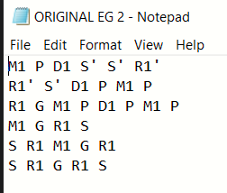
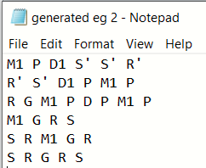

Accuracy – Numeric Metrics :
Accuracy – Actual Inputs:

Slide 11
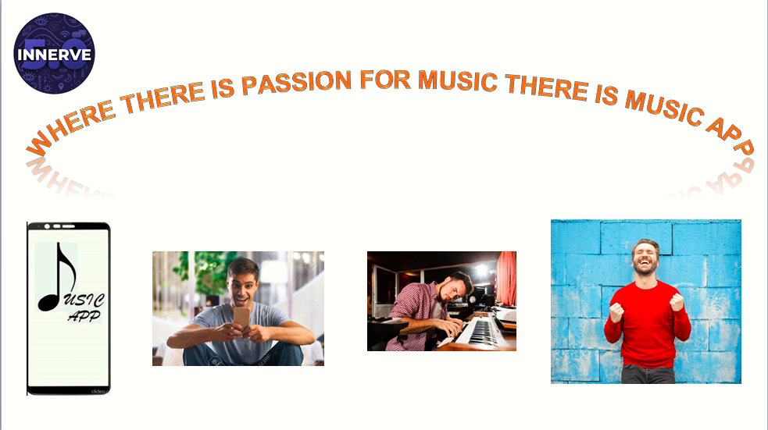

Slide 12


